Slide 1




Merck Animal Health Forecasting Project Week 16
Team: Abhishek Dixit, Benjamin Elbaz,
Anqi Huang, Shuang Wei
Advisor: Kris Iyer
Date: APR 29, 2016

Slide 2
Agenda
1 – Refined Model
2 – Sku Level Model for Nobivac
3 – Clustered Model for Nobivac
4 – One Model for all Nobivac Skus
5 – Modeling Approach for newly launched products

Slide 3
Refined Model
Granger Causality Test
- Determine whether one time series x statistically provides more information about future values about another time series y than past values of y alone
(e.g. Total Shipments vs. Sales Out; Sales Out vs. Sales In; Inventory vs. Sales In)
Error Metrics
Exponentially Weighted Error = [Error(1) + Error(2)/2 + Error(3)/4 + Error(4)/8]/1.875
Clustering Analysis
- based on pairwise correlations between monthly Sales In Quantities

Slide 4
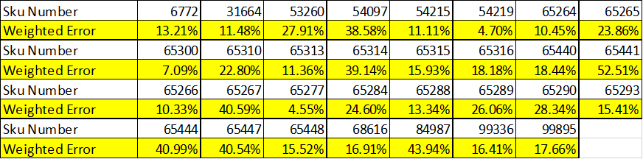
Sku Level Sales out Weighted Errors
Overall, 18 SKUs had Error Rate that is smaller than 20%.
Only 5 SKUs had Error Rate that is greater than 40%.

Slide 5
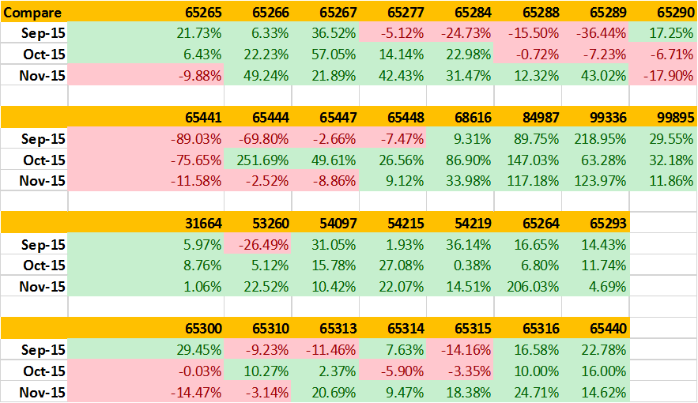

SKU Level Sales out DFA Comparison
Over 3 months period, there are 14 SKUs made improvements for this model.
15 SKUs had improvements only for some months.
1 SKU performed worse than EY’s current forecast.

Slide 6
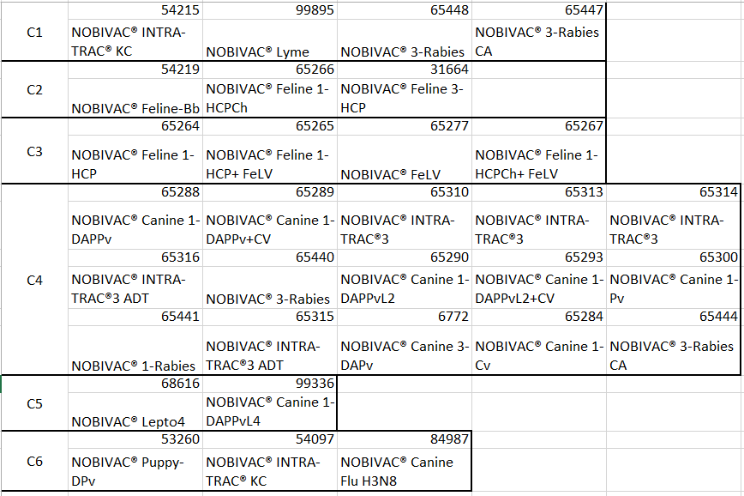
Nobivac Clusters
For C6, correlations < 0.5
Recommendation: Model the 3 skus individually

Slide 7
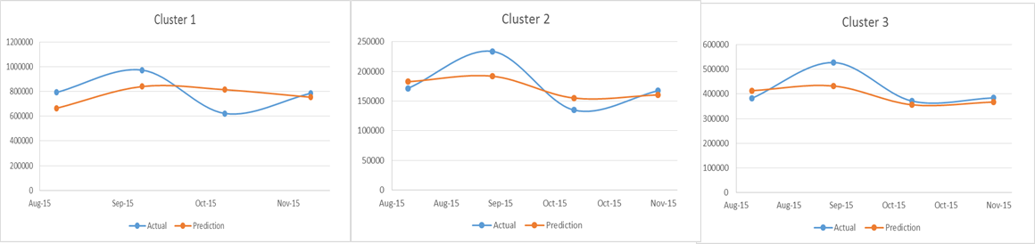
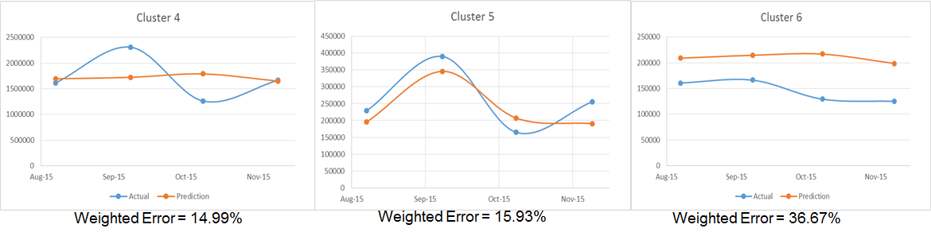
Cluster Model Sales Out Results

Slide 8
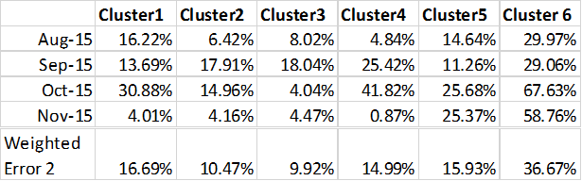
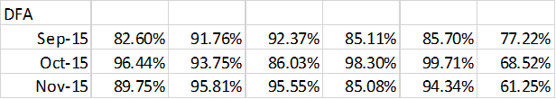
Cluster Model Sales Out Results
Monthly Error Rate & Weighted Error Rate

Slide 9
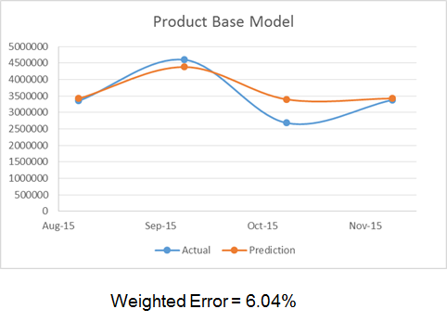
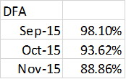
One Model for all Skus

Slide 10
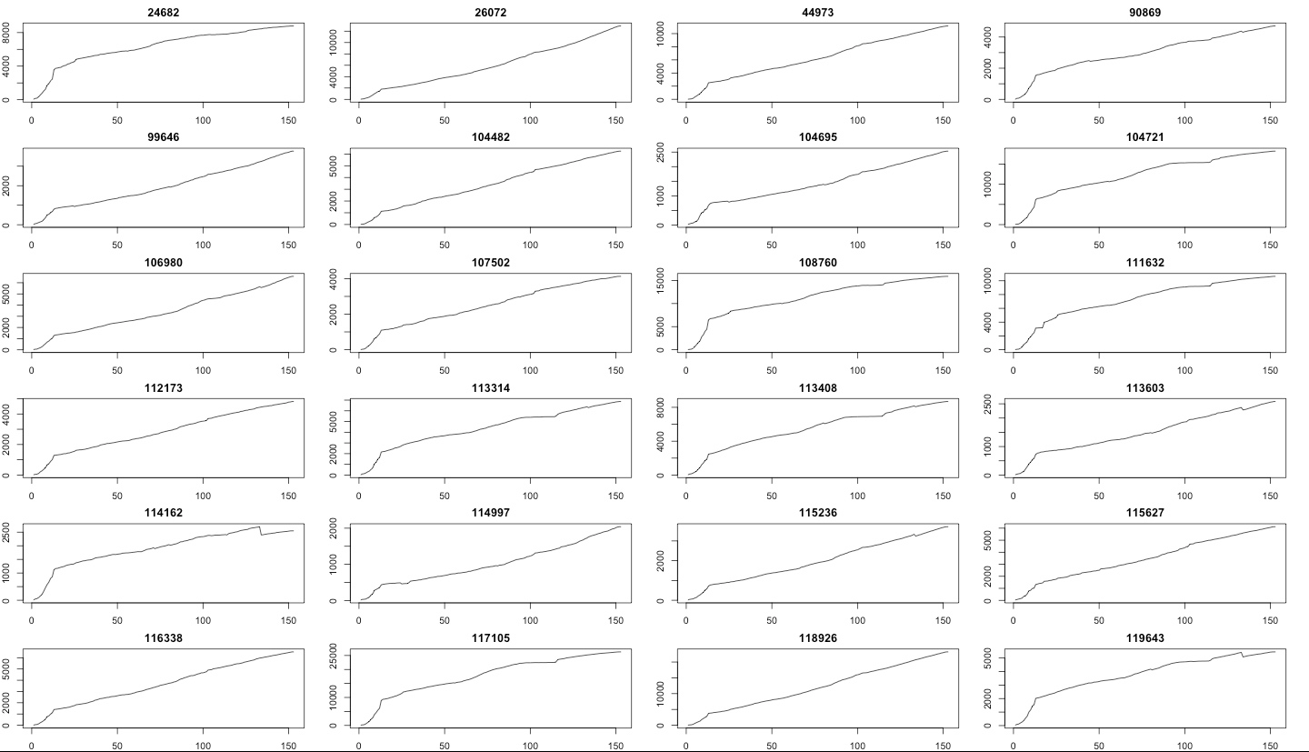
Modeling Approach – Activyl Cumulative Plots

